Slide 1


HEP NTUA Weekly Report 2/2/2022
George Bakas

Slide 2
Summary
ttX analysis:
We are writing the AN:
Basic outline along with text
Input all images that are needed for the analysis
Appendices that include
Response matrices, efficiencies, acceptance, purity and stability per year
Fiducial Measurements per year
Systematic uncertainties breakdown per year
Closure tests
Issues are handled on gitlab
Switch to |cosθ*|
Unfolded results (Parton & Particle Phase space)
JES uncertainties included
Z’ analysis:
Production for files that were missing
Integration of M1400 W14 for 2016_preVFP in analysis chain

Slide 3
Final Results Parton

Slide 4
Final Results Particle

Slide 5
Final Results Particle

Slide 6
Final Results Particle

Slide 7
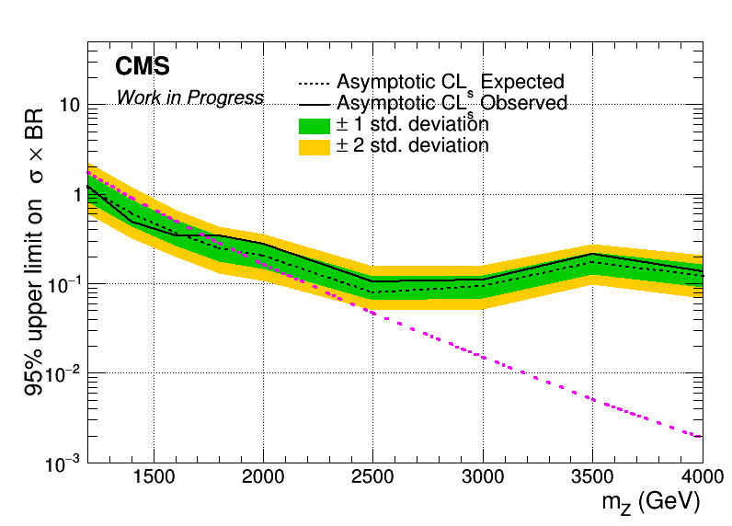
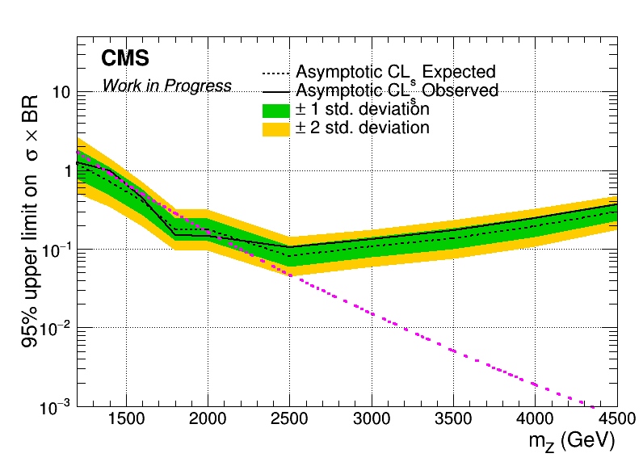
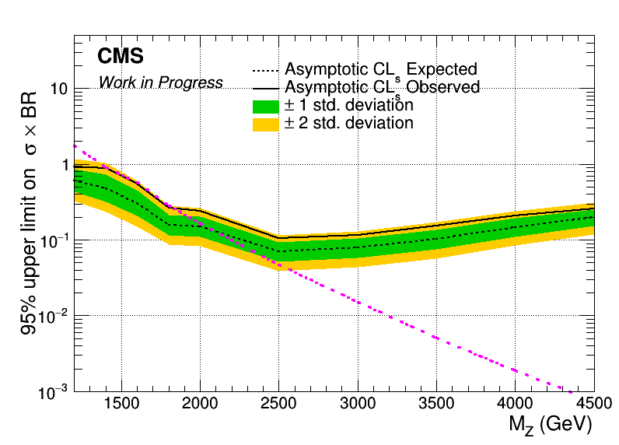
Brazilian Plots (2016_preVFP, 2017 and 2018) with sliding mJJ Cut
2016_preVFP
2017
2018

Slide 8
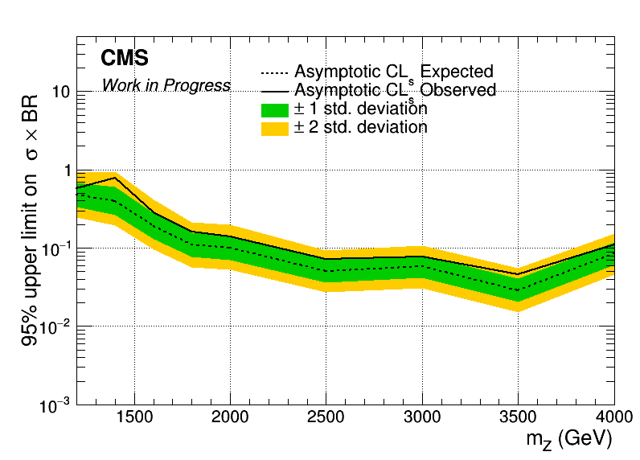
Combined Datacard for 2016_preVFP, 2017 and 2018
Mass Cut Mapping
{"mZ_1200_12":1000, "mZ_1400_14":1200, "mZ_1600_16":1400, "mZ_1800_18":1600, "mZ_2000_20":1600,
"mZ_2500_25":2000, "mZ_3000_30":2000, "mZ_3500_35":2000, "mZ_4000_40":2000, "mZ_4500_45":2000}

Slide 9
BACKUP

Slide 10
Summary
ttX analysis Pipeline Creation
We want to be able to handle all Nominal files and their variations in an automated way
This requires deciding consistent naming conventions and a efficient planning
Handling of:
Nominal
Parton Shower Weights
PDF Variations
JES
Scale Variations
bTagVariations
Top quark mass variations
Per year For all these we need to
Create template files that have 2btag and 0btag in Extended and Reduced jetMassSoftDrop phase space
9 variables (mJJ, pTJJ, yJJ, jetPt[0,1], jetY[0,1], chi, |cosTheta*|[0,1]
Template fit files (bkg qcd, bkg subdominant) and signal templates for all variations
Fit on extended signal region for all variations
Response matrices, Acceptance, Efficiency
Signal Extraction
Combine all Fiducial Level results (4 years) into 1 Extracted Signal for all variations
Unfold the combined result into Parton & Particle levels
Show systematic variations compared to the Nominal file
The same procedure must be done using different nominal files
Fill in 2btag histograms in our signal region in the parton
For each variation and each year
Combine all years together
Calculate systematics for samples other than the nominal

Slide 11
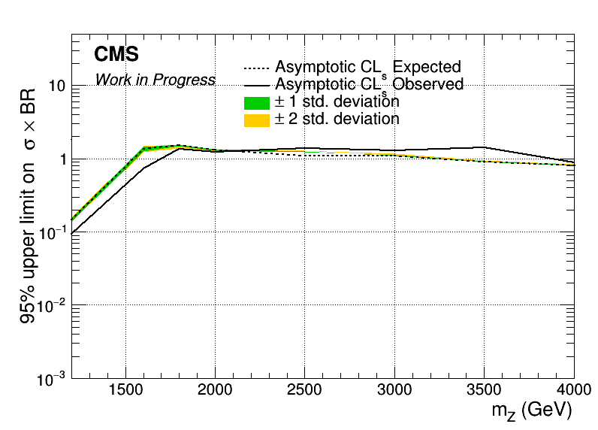
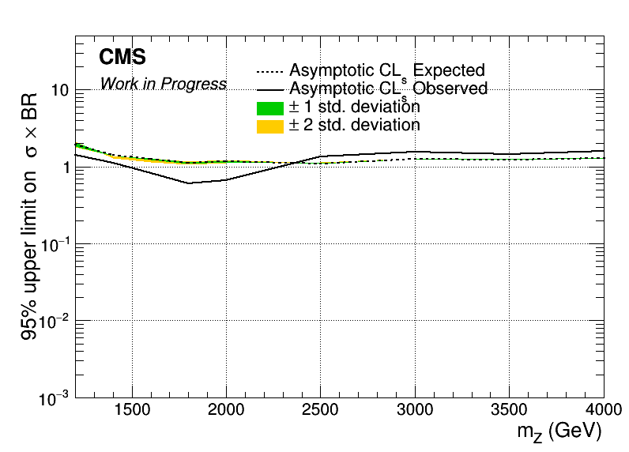

Brazilian Plots (2016_preVFP, 2017 and 2018) with sliding mJJ Cut wrt 2018
2016_preVFP
2017
2018

Slide 12
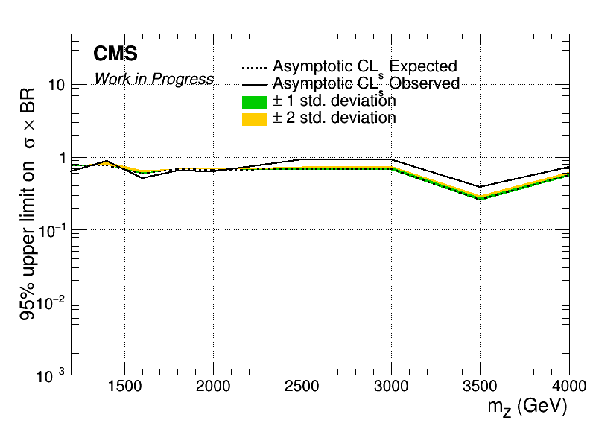
Combined Datacard for 2016_preVFP, 2017 and 2018 wrt 2018
Mass Cut Mapping
{"mZ_1200_12":1000, "mZ_1400_14":1200, "mZ_1600_16":1400, "mZ_1800_18":1600, "mZ_2000_20":1600,
"mZ_2500_25":2000, "mZ_3000_30":2000, "mZ_3500_35":2000, "mZ_4000_40":2000, "mZ_4500_45":2000}

